Slide 1
2024 ETH Quantum Hackathon Qilimanjaro challenge Process management problem
Abdul Fatah
Francesco Zanasi
Marianna Ruggeri
Pierre Wan-Fat

Slide 2
A journey in FULL-STACK Quantum Engineering

Slide 3
Real-life optimization problem

Slide 4
Real-life optimization problem
Hamiltonian engineering

Slide 5
Real-life optimization problem
Hamiltonian engineering
Comparison of quantum optimization methods

Slide 6
Real-life optimization problem
Hamiltonian engineering
Comparison of quantum optimization methods
Chip engineering

Slide 7
A real-life optimization problem
Task 1
15 CHF
Task 2
10 CHF
Task 3
20 CHF
Task 4
5 CHF

Slide 8
A real-life optimization problem
Task 1
15 CHF
Task 2
10 CHF
Task 3
20 CHF
Task 4
5 CHF
???

Slide 9
A real-life optimization problem
Knapsack problem (or “knaps”)

Slide 10
A real-life optimization problem
Knapsack problem (or “knaps”)
NP-complete problem! (No fast algorithm.)

Slide 11
A real-life optimization problem
Knapsack problem (or “knaps”)
Finance Logistics Engineering …

Slide 12





Knaps problem formulation
$$n$$
number of tasks
$$d_{i}∈N^{n}$$
durations of tasks
$$D∈N$$
max duration
$$v_{i}∈N^{n}$$
values of tasks
$$x_{i}∈{\{0,1\}}^{n}$$
is the item i selected?

Slide 13





Knaps problem formulation
$$n$$
number of tasks
$$4$$
$$d_{i}∈N^{n}$$
durations of tasks
$$(8, 4, 16, 11)$$
$$D∈N$$
max duration
$$25$$
$$v_{i}∈N^{n}$$
values of tasks
$$(15,10, 20, 5)$$
$$x_{i}∈{\{0,1\}}^{n}$$
is the item i selected?
$$???$$
Task 1
15 CHF
Task 2
10 CHF
Task 3
20 CHF
Task 4
5 CHF
???

Slide 14

Knaps problem formulation
$$n$$
number of tasks
$$4$$
$$d_{i}∈N^{n}$$
durations of tasks
$$(8, 4, 16, 11)$$
$$D∈N$$
max duration
$$25$$
$$v_{i}∈N^{n}$$
values of tasks
$$(15,10, 20, 5)$$
$$x_{i}∈{\{0,1\}}^{n}$$
is the item i selected?
$$(1,0,1,0)$$
Task 1
15 CHF
Task 2
10 CHF
Task 3
20 CHF
Task 4
5 CHF
Task 1
15 CHF
Task 3
20 CHF
???

Slide 15
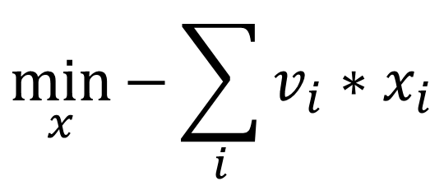
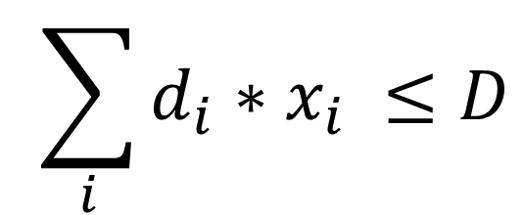
Knaps problem formulation
$$\min_{x}{−\sum_{i}{v_{i}∗x_{i}}}$$
Value of tasks
$${\sum_{i}{d_{i}∗x_{i}}} ≤D$$
Duration constraint

Slide 16

Hamiltonian engineering
$$H$$
Represents the energy of a system
Eigenvalues = possible energies

Slide 17
Hamiltonian engineering
$$H$$
Represents the energy of a system
Eigenvalues = possible energies
Predict how Nature behaves

Slide 18
Hamiltonian engineering
Make Nature “work” for us
Predict how Nature behaves

Slide 19
Hamiltonian engineering
Make Nature “work” for us
Engineer Hamiltonians
so the ground state is
a solution to our problem

Slide 20
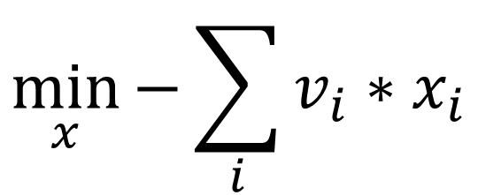
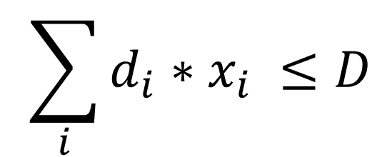
Hamiltonian engineering for Knaps
Transform
$$\min_{x}{−\sum_{i}{v_{i}∗x_{i}}}$$
$${\sum_{i}{d_{i}∗x_{i}}} ≤D$$
into a cost function!

Slide 21
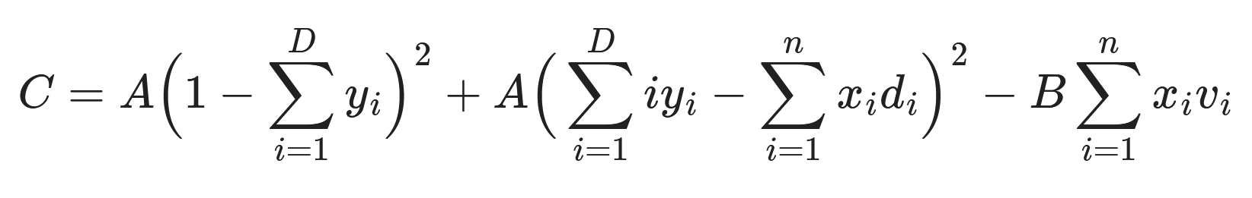
Hamiltonian engineering for Knaps
Cost function (lower is better)

Slide 22
Hamiltonian engineering for Knaps
Total value

Slide 23

Hamiltonian engineering for Knaps
$$y_{i}∈{\{0,1\}}^{n}$$
D “slack variables”
Represents the total duration.

Slide 24
Hamiltonian engineering for Knaps
Only one of them is 1
The distance must be between 1 and D
$$y_{i}∈{\{0,1\}}^{n}$$
D “slack variables”
Represents the total duration.

Slide 25
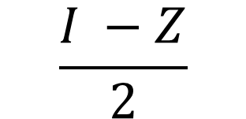
Hamiltonian engineering for Knaps
$$\frac{I −Z}{2}$$

Slide 26
Hamiltonian engineering for Knaps
We try to diagonalize H, and find the lowest eigenvalue.
But there are too many qubits! N + D = 6 + 22 = 28

Slide 27
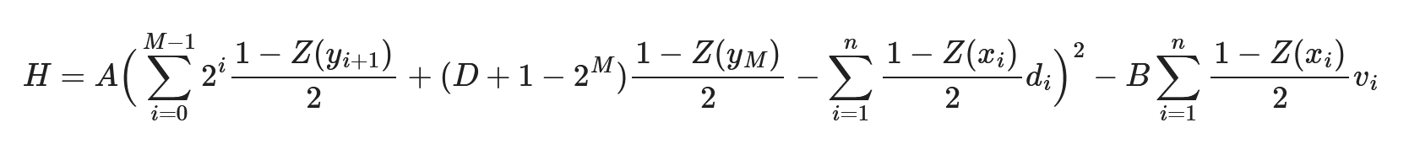
Hamiltonian engineering for Knaps
Use the “log trick”: encode the total duration in binary.

Slide 28
Hamiltonian engineering for Knaps
Use the “log trick”: encode the total duration in binary.
10 qubits, the Hamiltonian can be diagonalized! 🎉
We find the exact solution!

Slide 29
Fewer qubits!
What if we can only use 6 qubits?
Let’s get rid of the slack variables!

Slide 30

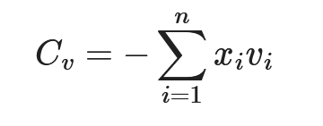

Fewer qubits!
(does not change)
???

Slide 31
Fewer qubits!
D
Total duration

Slide 32
Fewer qubits!
0
D
Total duration

Slide 33
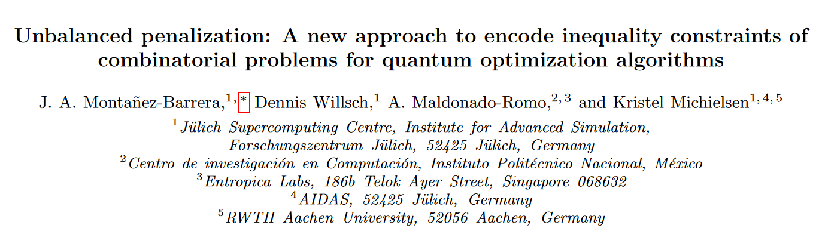
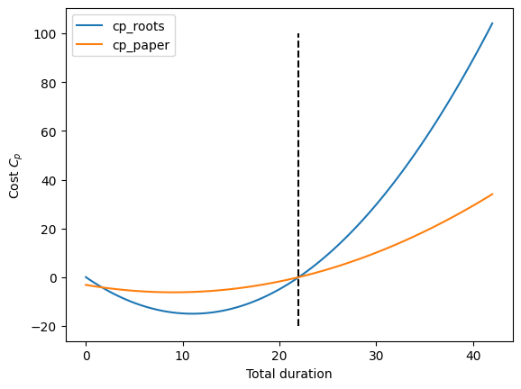
Fewer qubits!

Slide 34
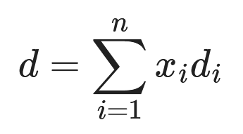
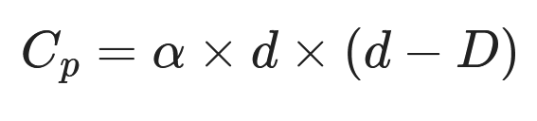
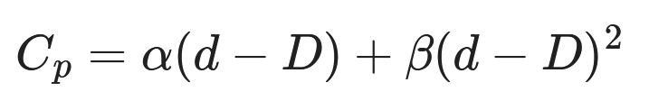
Fewer qubits!
cp_roots
cp_paper

Slide 35
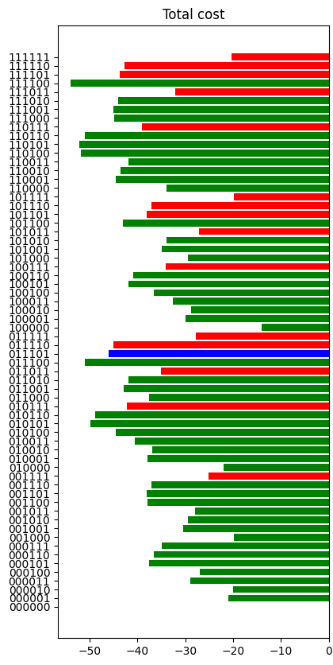
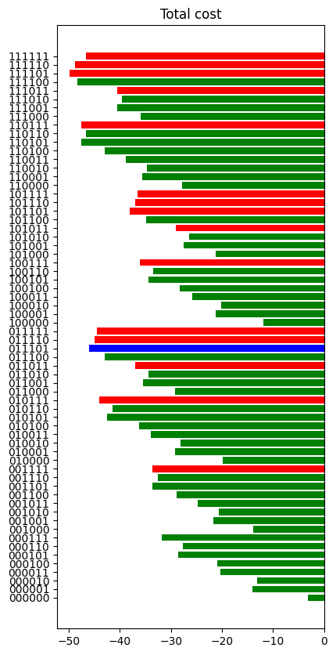
Fewer qubits, but less Precision…
Invalid state
Valid state
Best state
cp_roots
cp_paper

Slide 36
Fewer qubits, but less Precision…
So far, we used Hamiltonian diagonalization (exact, but slow, and not quantum!)

Slide 37
Fewer qubits, but less Precision…
So far, we used Hamiltonian diagonalization (exact, but slow, and not quantum!)
Let’s use (simulate) quantum methods:
QAOA
Quantum Adiabatic Evolution

Slide 38
QAOA
Variational quantum algorithm.
Apply parameterized rotations to transform an initial state into one that encodes the solution.

Slide 39
QAOA
Results: with default parameters, QAOA does not find the ground state of the first Hamiltonian.
The solution is much worse than the optimal solution: 37 vs 46.

Slide 40
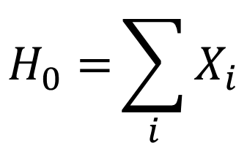

Quantum Adiabatic Evolution
We make the system evolve between
$$H_{0}={\sum_{i}{X_{i}}}$$
And previously found
$$H$$

Slide 41
Quantum Adiabatic Evolution
We found the ground states of both Hamiltonians with Quantum Adiabatic Evolution.

Slide 42
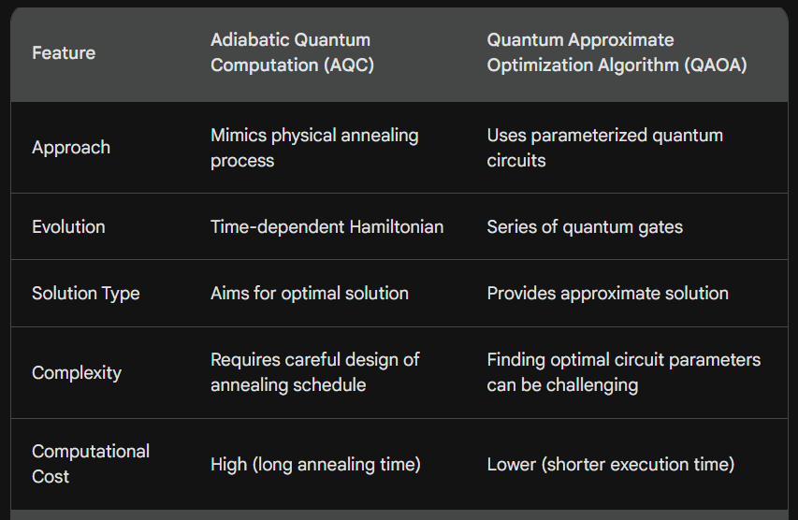
QAOA vs Quantum Adiabatic Evolution

Slide 43
Bottom line on fewer qubits…
The new penalty is not perfect and modifies the ground state of the resulting Hamiltonian.

Slide 44
Bottom line on fewer qubits…
The new penalty is not perfect and modifies the ground state of the resulting Hamiltonian.
On our experiment, this seems like an acceptable tradeoff, given the number of qubits saved.

Slide 45
Chip engineering
We now want to run our circuit on real hardware, with a quantum adiabatic evolution strategy!
We design our circuit based on Qilimanjaro’s fluxmons.

Slide 46
Chip engineering
We now want to run our circuit on real hardware, with a quantum adiabatic evolution strategy!
We design our circuit based on Qilimanjaro’s fluxmons.
The instance uses 3 qubits, with couplings between each pair of qubits (Z_i Z_j terms).

Slide 47
Simulation of Evolution
Choosing the right schedule is key.
Adiabatic Theorem: a time-dependent Hamiltonian will remain in the instantaneous ground state provided the Hamiltonian changes sufficiently slowly.

Slide 48
Simulation of Evolution
T ~ 1 / ΔE²
ΔE is the energy gap between the first two levels.

Slide 49
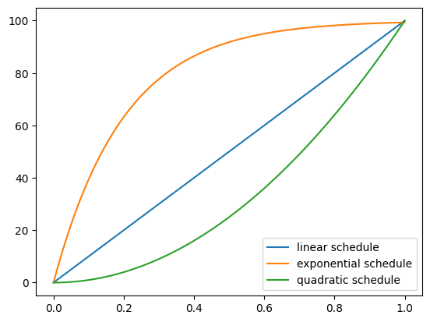
Adiabatic Evolution Schedule

Slide 50
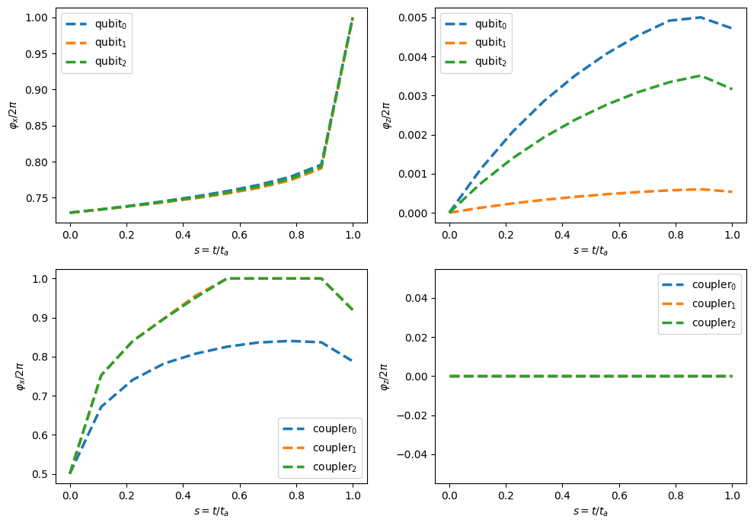
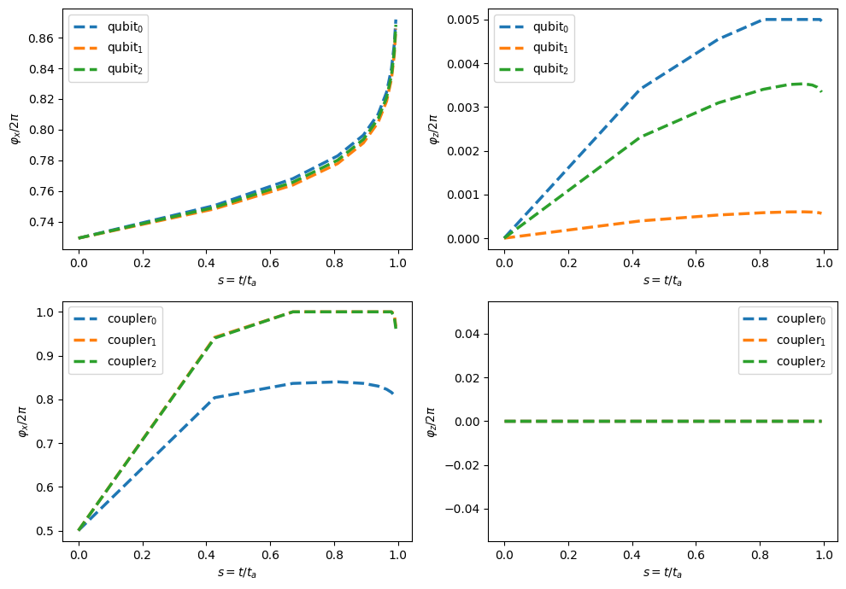
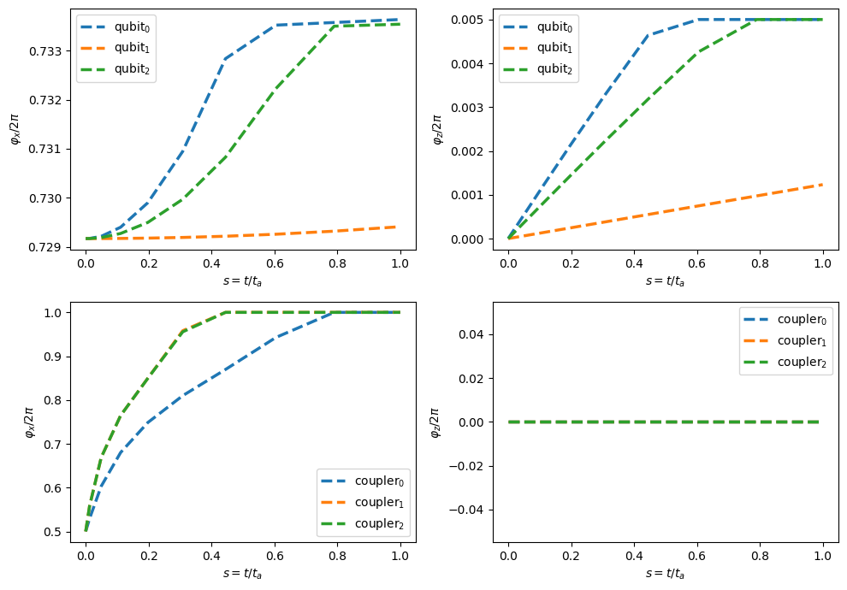
Simulation of fluxes
Quadratic schedule
Linear schedule
Exponential schedule

Slide 51
Simulation of fluxes: energy levels at t = 10ns
1804.5
1814.0
1820.9
1823.5
1826.5
1962.9
1972.4
1979.1
1981.8
1984.8
2225.7
2236.6
2240.4
2242.7
2251.8
Linear
schedule
Exponential
schedule
Quadratic
schedule
Lower is better

Slide 52
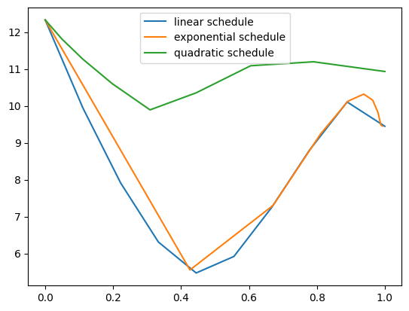
Simulation of fluxes: energy gaps over time

Slide 53
Minimum energy gaps
5.47
5.55
9.89
Linear
schedule
Exponential
schedule
Quadratic
schedule
Higher is better
(more relaxed constraint on ΔT)

Slide 54
further improvements
Improve schedule with an optimizer.
Schedule
Energy spectrum
Energy gap
Optimizer
“Classic” optimizers Differentiable solvers (PyTorch)
Neural networks

